Slide 1
Study on Predicting Social Unrest Using GDELT Data
Anol Kurian V. (5626-8544)
Aadithya Kandeth (6980-2791

Slide 2

Introduction
News Data : readily available source of big data.
We aim to predict and analyze global societal unrest events based on news.
Our data encompasses GDELT and ACLED datasets for news and unrest events respectively.

Slide 3
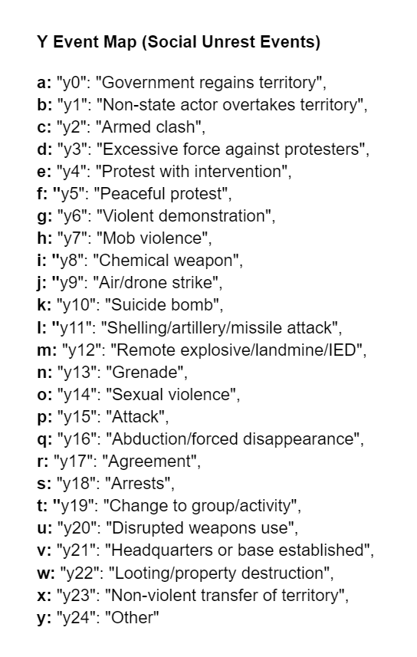
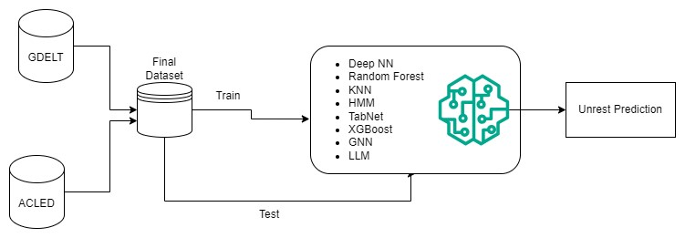
Proposed Solution

Slide 4
Motivation
Aid humanitarian organizations
Mitigate Unrest Events
Public Safety and Emergency Response
Resource Allocation
Informed Policy-Making

Slide 5

Challenges
Technical and Financial Limitations:
Large Data Size(250 GB)
Computational restrictions
Financial restrictions
Research Limitations
Lack of baselines for evaluation
Negligible research on causal inference
Inherent complexity of unrest event prediction

Slide 6
Novelty
Graph Neural Networks
Large Language Models
Transfer Learning approaches
Combining ACLED Data for Unrest Events

Slide 7

Results
Traditional Models: Balance between high accuracy and efficient training time, ideal for structured, tabular data.
LLM Advantages: Requires minimal training resources due to their pre-trained nature, excelling in analyzing textual
GNN Capabilities: Specializes in representing interconnected data but demands significant computational resources.
Model Effectiveness: While newer models like LLMs and GNNs generally surpass traditional methods in complex pattern modeling, the effectiveness of any model is highly dependent on the dataset and specific task, with traditional models still viable in scenarios prioritizing interpretability and structured data.

Slide 8

Demo and Code Walkthrough

